Slide 1
Machine Learning & Deep Learning
2018级计科2 叶劲亨

Slide 2

人工智能
目标
机器学习
手段
深度学习
Source of image: https://blogs.nvidia.com.tw/2016/07/whats-difference-artificial-intelligence-machine-learning-deep-learning-ai/
Notes:
本能

Slide 3
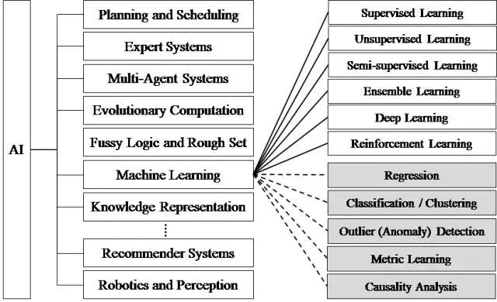
人工智能——我们的目标
人工智能研究分支

Slide 4
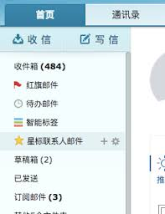

人工智能的得力干将——机器学习
机器学习最基本的做法，是使用算法来解析数据、从中学习，然后对真实世界中的事件做出分类和预测等任务。

Slide 5
机器学习
传统的算法包括决策树、聚类、贝叶斯分类、支持向量机等等。
从训练数据是否有labels来分，机器学习算法可以分为监督学习（如分类问题）、无监督学习（如聚类问题）、半监督学习。

Slide 6
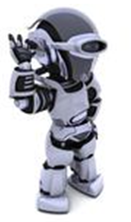
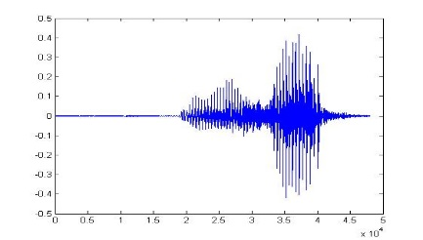
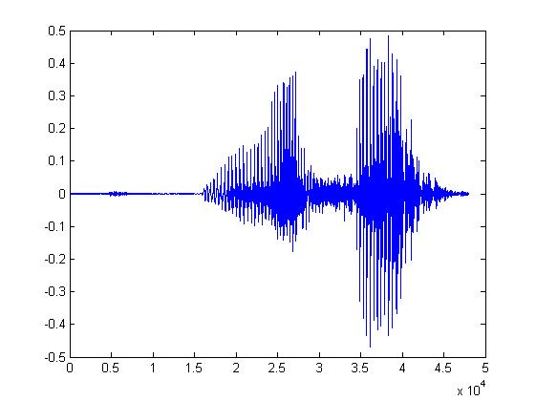
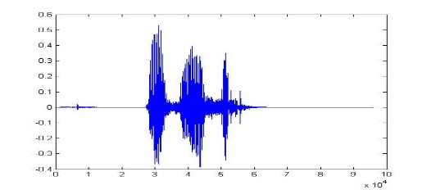
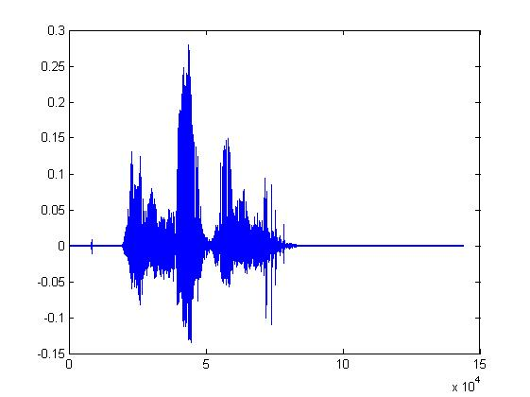
机器能“听见”
Learning ......
“Hi”
“How are you”
You said “Hello”
“Good bye”
You write the program for learning.
A large amount of audio data

Slide 7
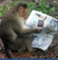

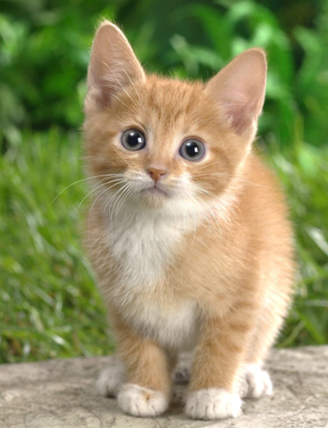

机器能“看见”
Learning ......
“monkey”
“cat”
This is “cat”
“dog”
You write the program for learning.
A large amount of images

Slide 8

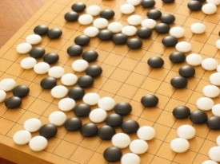
机器学习 ≈ 找到一个函数
Speech Recognition
Image Recognition
Playing Go
Dialogue System
“How are you”
“Cat”
“5-5”
(next move)
“How are you?”
“I am fine.”
(what the user said)
(system response)

Slide 9
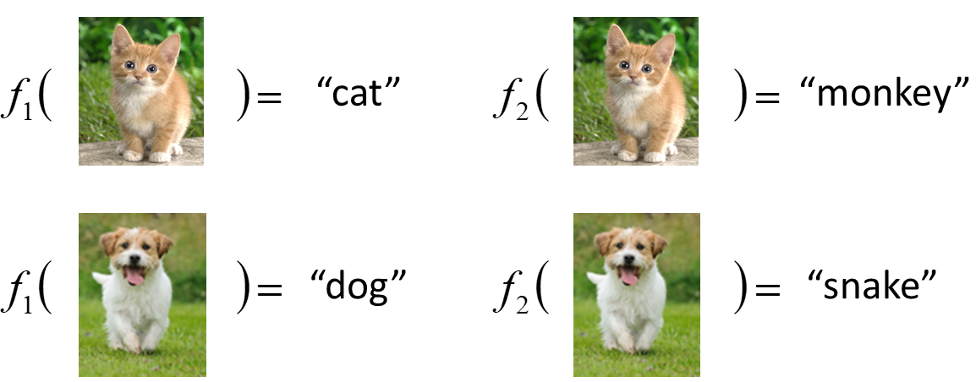
Framework
Image Recognition:
“cat”
A set of function
Model
Better!
Goodness of function f
Training
Data
data:
label:
“monkey”
“cat”
“dog”
Notes:
Repeat again

Slide 10
Framework
Image Recognition:
“cat”
A set of function
Model
Training
Testing
“cat”
Step 1
Goodness of function f
Pick the “Best” Function
Using
Step 2
Step 3
Training
Data
“monkey”
“cat”
“dog”
Notes:
Repeat again

Slide 11
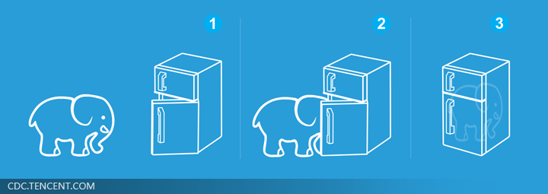
机器学习其实很简单 ……
Step 1: define a set of function
Step 2: goodness of function
Step 3: pick the best function
Different Tasks (任務)
Step 0: What kind of function do you want to find?
就好像把大象放进冰箱 ……

Slide 12
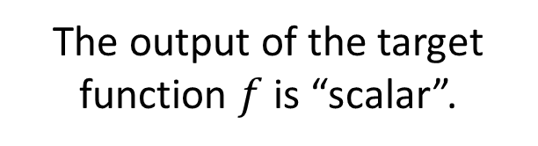
Regression (回归)
Regression
The output of the target function $f$ is “scalar”.
Predict
PM2.5
PM2.5 today
f
PM2.5 yesterday
PM2.5 tomorrow
…….
(scalar)
Training Data:
Output:
Input:
9/03 PM2.5 = 100
9/01 PM2.5 = 63
9/02 PM2.5 = 65
Input:
Output:
9/12 PM2.5 = 30
9/13 PM2.5 = 25
9/14 PM2.5 = 20

Slide 13
Classification (分类)
Binary Classification (二元分类)
Multi-class Classification (多类别分类)
Yes or No
Class 1, Class 2, … Class N
Function f
Function f
Input
Input

Slide 14
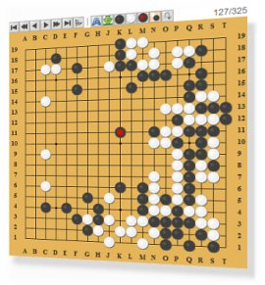

多类别分类
Each position is a class
Playing GO
(19 x 19 classes)
位置1
Function
位置2
位置n
Next move
Notes:
Reinforcement learning?

Slide 15



Generation (生成)
https://www.thiswaifudoesnotexist.net/
GAN(Generative Adversarial Network对抗生成网络)能帮你做到这些

Slide 16
机器学习其实很简单 ……
Step 1: define a set of function
Step 2: goodness of function
Step 3: pick the best function
Step 0: What kind of function do you want to find?
就好像把大象放进冰箱 ……

Slide 17
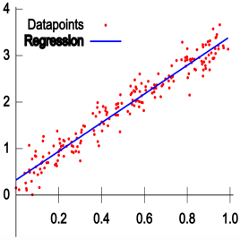

SuperVised Learning(监督学习)
一般使用Loss Function(损失函数)来定义一个函数的好坏。
“monkey”
Function
“cat”
“dog”
Classification
Regression

Slide 18
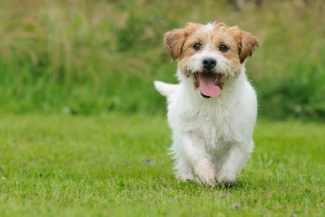

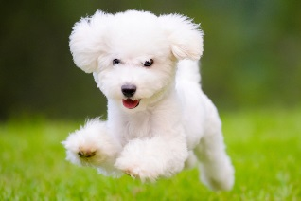
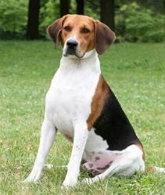
Semi-supervised Learning(半监督学习)
如果训练集不是所有都有label呢...
Labelled data
cat
dog
Unlabeled data
(Images of cats and dogs)

Slide 19



Unsupervised Learning(无监督学习)
训练集甚至没有任何label呢...

Slide 20
机器学习其实很简单 ……
Step 1: define a set of function
Step 2: goodness of function
Step 3: pick the best function
Step 0: What kind of function do you want to find?
就好像把大象放進冰箱 ……

Slide 21
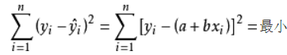
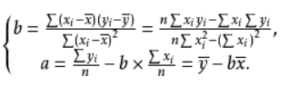
Review 一元线性回归

Slide 22
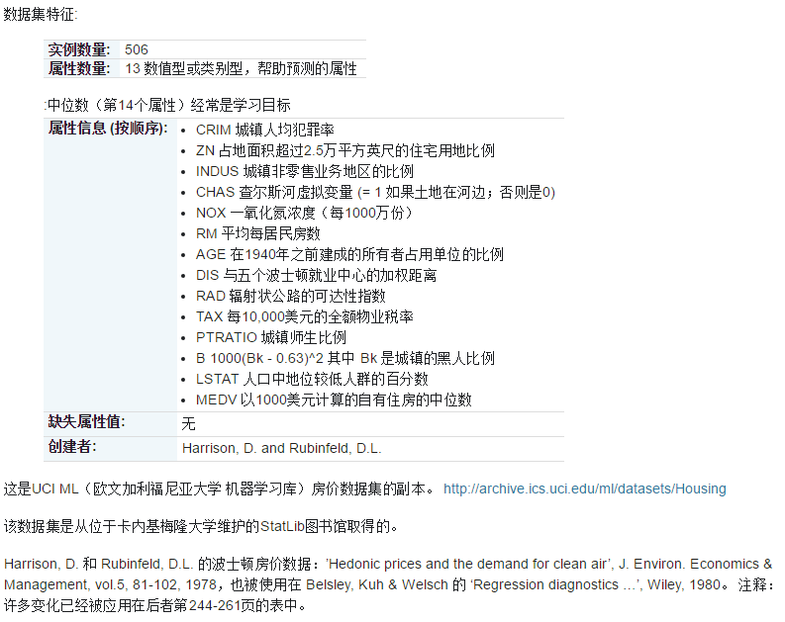
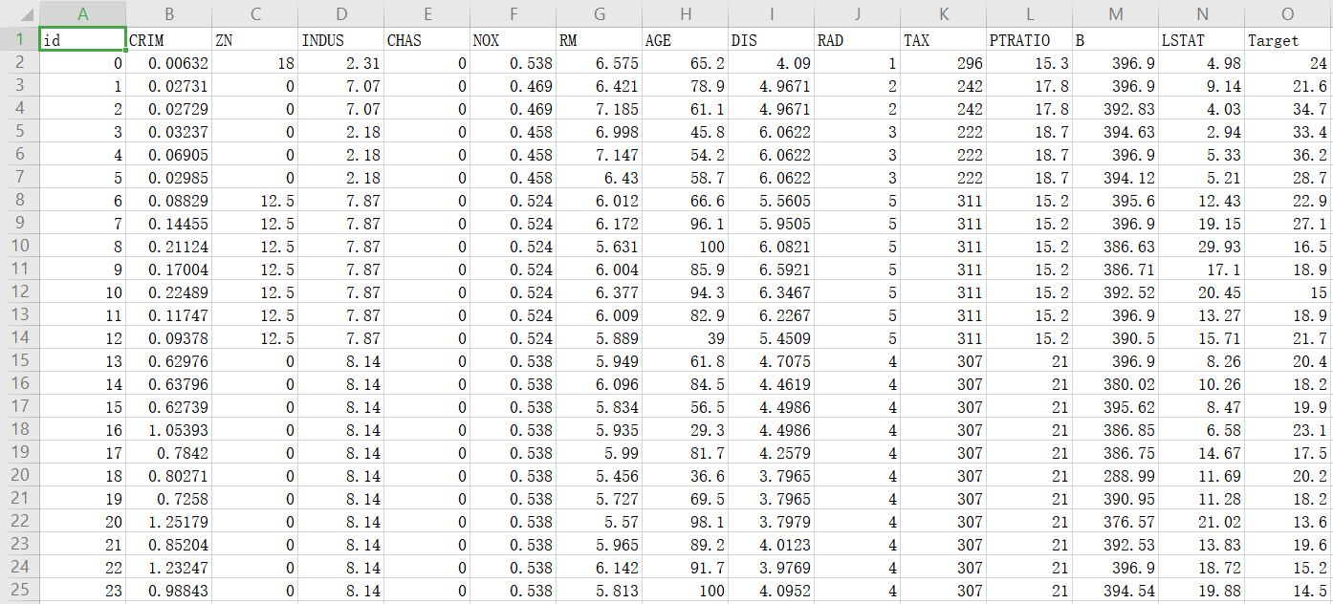
如果自变量很多...... case: 房价预测

Slide 23
Gradient Descent
Notes:
amazon-dsstne記得加上 pyroch

Slide 24
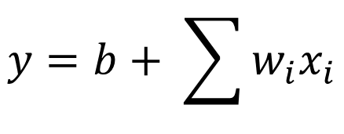
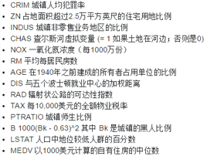
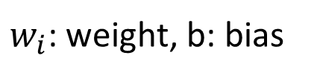
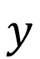
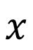
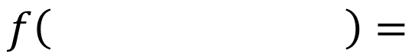
Step 1: Model
w and b are parameters (can be any value)
A set of function
Model
housing price
$$x$$
$$y$$
$$f\left( \right)=$$
$$y=b+ \sum{w_{i}x_{i}}$$
Linear model:
feature
$w_{i}$: weight, b: bias

Slide 25
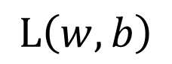
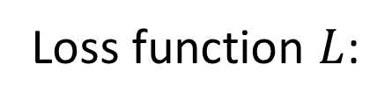
Step 2: Goodness of Function
A set of function
Loss function $L$:
Model
Input: a function, output: how bad it is
Estimation error
Goodness of function f
Estimated y based on input function
Sum over examples
Training
Data
$$L\left(w,b\right)$$
vector
vector

Slide 26
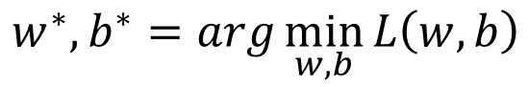
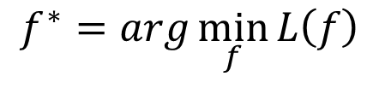
Step 3: Best Function
A set of function
Model
Goodness of function f
Pick the “Best” Function
$$f^{∗}=\arg{\min_{f}{L\left(f\right)}}$$
Gradient Descent
$$w^{∗},b^{∗}=arg\min_{w,b}{L\left(w,b\right)}$$
Training
Data
Notes:
http://speech.ee.ntu.edu.tw/~tlkagk/courses/LA_2016/Lecture/orthogonal%20projection%20(v2).ecm.mp4/index.html

Slide 27

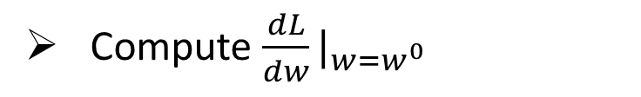
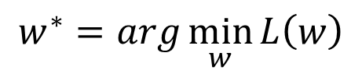
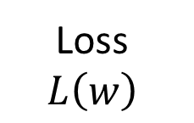
Step 3: Gradient Descent
http://chico386.pixnet.net/album/photo/171572850
$$w^{∗}=arg\min_{w}{L\left(w\right)}$$
Consider loss function 𝐿(𝑤) with one parameter w:
(Randomly) Pick an initial value w⁰
Compute $\frac{dL}{dw}|_{w=w^{0}}$
Loss
$$L\left(w\right)$$
w⁰

Slide 28
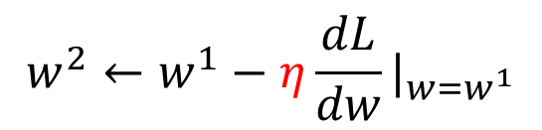
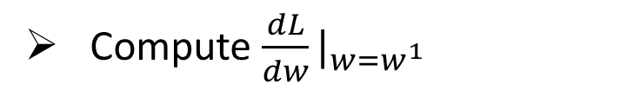

Step 3: Gradient Descent
$$w^{∗}=arg\min_{w}{L\left(w\right)}$$
Consider loss function 𝐿(𝑤) with one parameter w:
(Randomly) Pick an initial value w⁰
Compute $\frac{dL}{dw}|_{w=w^{0}}$
$$w^{1}←w^{0}−η\frac{dL}{dw}|_{w=w^{0}}$$
Loss
$$L\left(w\right)$$
Compute $\frac{dL}{dw}|_{w=w^{1}}$
$$w^{2}←w^{1}−η\frac{dL}{dw}|_{w=w^{1}}$$
…… Many iteration
Local minima
global minima
w⁰
w¹
w²
w^{T}

Slide 29
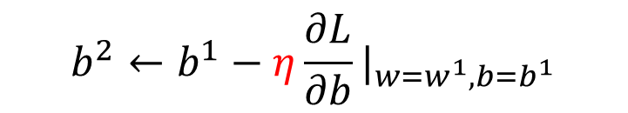
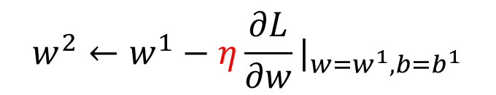
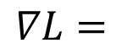
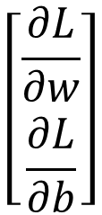

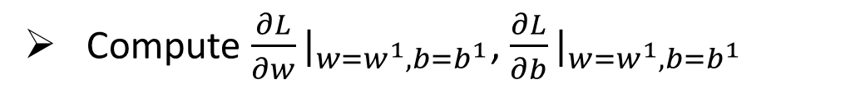

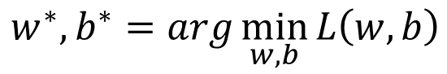
Step 3: Gradient Descent
$$\left[\begin{aligned}\frac{∂L}{∂w} \\ \frac{∂L}{∂b}\end{aligned}\right]$$
$$∇L=$$
gradient
How about two parameters?
$$w^{∗},b^{∗}=arg\min_{w,b}{L\left(w,b\right)}$$
(Randomly) Pick an initial value w⁰, b⁰
Compute $\frac{∂L}{∂w}|_{w=w^{0},b=b^{0}}$, $\frac{∂L}{∂b}|_{w=w^{0},b=b^{0}}$
$$w^{1}←w^{0}−η\frac{∂L}{∂w}|_{w=w^{0},b=b^{0}}$$
$$b^{1}←b^{0}−η\frac{∂L}{∂b}|_{w=w^{0},b=b^{0}}$$
Compute $\frac{∂L}{∂w}|_{w=w^{1},b=b^{1}}$, $\frac{∂L}{∂b}|_{w=w^{1},b=b^{1}}$
$$w^{2}←w^{1}−η\frac{∂L}{∂w}|_{w=w^{1},b=b^{1}}$$
$$b^{2}←b^{1}−η\frac{∂L}{∂b}|_{w=w^{1},b=b^{1}}$$
Notes:
鄭凱文

Slide 30
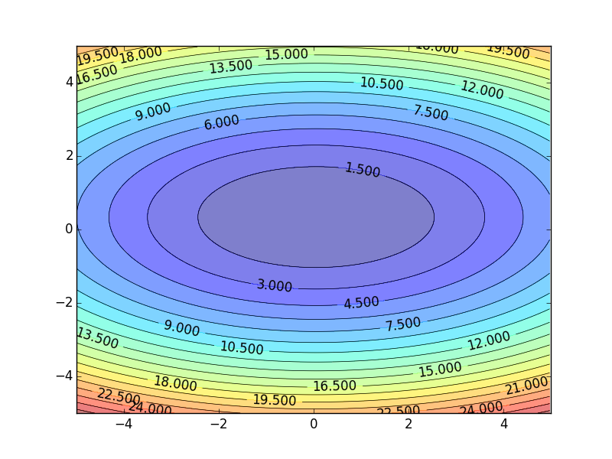
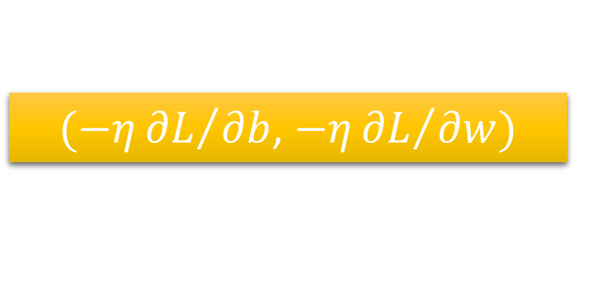
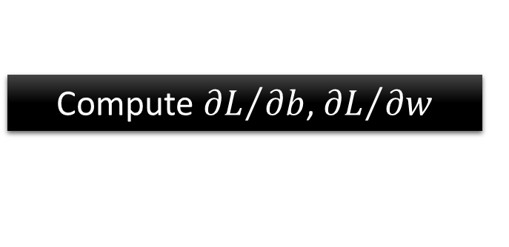

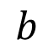
Step 3: Gradient Descent
Color: Value of Loss L(w,b)
$$w$$
$(−η{∂L}/{∂b}$, $−η{∂L}/{∂w})$
Compute ${∂L}/{∂b}$, ${∂L}/{∂w}$
$$b$$
Notes:
Don’t worry. In linear regression, the loss function L is convex.
No local minima
Questions: image you are playing AOC
A network can have millions of parameters.
Backpropagation is the way to compute the gradients efficiently (not today)
Ref: http://speech.ee.ntu.edu.tw/~tlkagk/courses/MLDS_2015_2/Lecture/DNN%20backprop.ecm.mp4/index.html

Slide 31
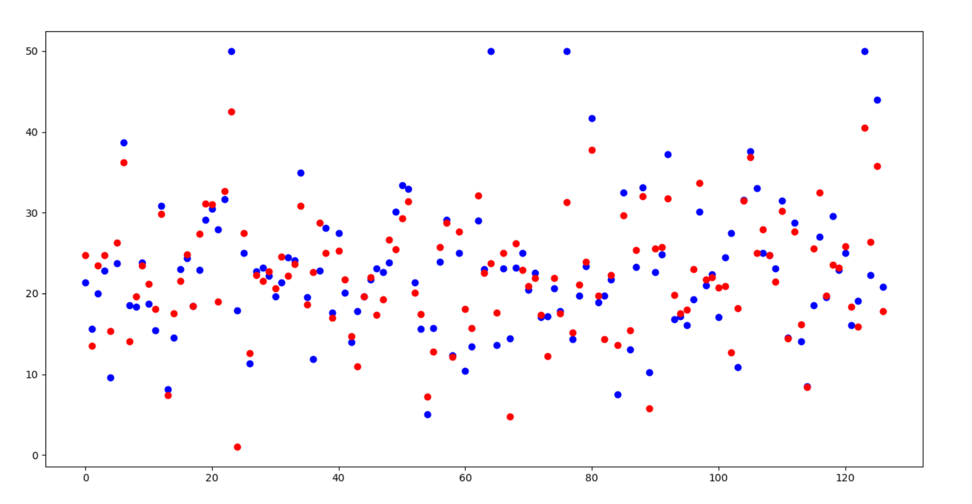
在测试集的预测结果
房价
房屋id

Slide 32
Deep Learning(深度学习)

Slide 33
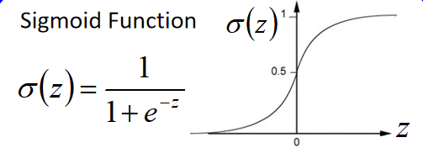
Neural Network (神经网络)
Neuron (神经元)
A simple function
…
…
…
…
Activation function
weights
bias
Weights and biases are called network parameters
Notes:
sigmoid

Slide 34
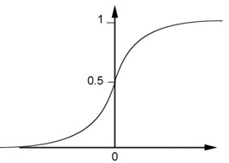
Neural Network (神经网络)
Neuron
Sigmoid Function
2
1
4
-1
-2
0.98
Activation function
-1
1
weights
1
bias
Notes:
sigmoid

Slide 35
Neural Network (神经网络)
……
y₁
……
y₂
“2”
……
……
……
……
……
……
yn
Input
Layer 1
Layer 2
Layer L
Output

Slide 36

case：手写数字辨识

Slide 37


Input
Output
y₁
is 0
0.1
y₂
is 1
0.7
……
Output: “1”
……
……
y₁₀
0.2
is 9
16 x 16 = 256
……
y₁
is 0
……
y₂
is 1
“2”
……
……
……
……
……
……
……
y₁₀
is 9
Input
Layer 1
Layer 2
Layer L
Output

Slide 38

预测的结果——准确率高达98%

Slide 39



Deep = Many hidden layers
ILSVRC比赛
22 layers
19 layers
8 layers
6.7%
7.3%
16.4%
AlexNet (2012)
VGG (2014)
GoogleNet (2014)

Slide 40

Deep = Many hidden layers
88 layers
152 layers
More layers, More Strong?
3.57%
7.3%
6.7%
16.4%
AlexNet (2012)
VGG
(2014)
GoogleNet
(2014)
Residual Net
(2015)
广州塔
Notes:
，曾於2004年12月31日至2010年1月4日間擁有世界第一高樓的紀錄

Slide 41









深度学习框架
libdnn
台大周伯威
同學開發

Slide 42
Reference
李宏毅深度学习课程http://speech.ee.ntu.edu.tw/~tlkagk/courses.html
人工智能、机器学习和深度学习的区别? https://www.zhihu.com/question/57770020

Slide 43
Thanks for Watching
2018级计科2 叶劲亨

